Slide 1
ASP .NET MVC 4
27 Apr 18 | Start
Appendix
Online

Slide 2
ASP.NET MVC 4
Ch | Date
1 | ddmmmyy
2
3
4
5
6
7
8
Programming ASP.NET MVC 4 10 2012

Slide 3
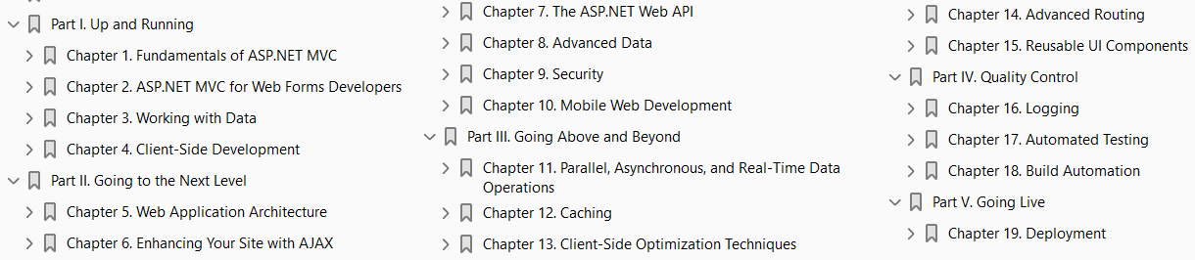

Slide 4
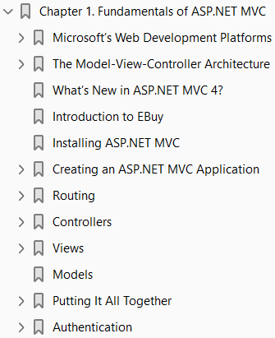
1
Fundamentals of ASP.NET MVC

Slide 5
Intro
Microsoft ASP.NET MVC is a web application development framework built on top of Microsoft’s popular and mature .NET Framework.
The ASP.NET MVC Framework leans heavily on proven developmental patterns and practices that place an emphasis on a loosely coupled application architecture and highly maintainable code.
In this chapter we’ll take a look at the fundamentals of what makes ASP.NET MVC tick—from its proud lineage and the architectural concepts on which it is built, to the use of Microsoft Visual Studio 2011 to create a fully functioning ASP.NET MVC web application.
Then we’ll dive into the ASP.NET MVC web application project and see just what ASP.NET MVC gives you right from the start, including a working web page and built-in forms authentication to allow users to register and log in to your site.
By the end of the chapter, you’ll have not only a working ASP.NET MVC web application, but also enough understanding of the fundamentals of ASP.NET MVC to begin building applications with it immediately.
The rest of this book simply builds on these fundamentals, showing you how to make the most of the ASP.NET MVC Framework in any web application.

Slide 6
Microsoft’s Web Development Platforms
Understanding the past can be a big help in appreciating the present; so, before we get into what ASP.NET MVC is and how it works, let’s take a minute to see just where it came from.
Long ago, Microsoft saw the need for a Windows-based web development platform, and the company worked hard to produce a solution.
Over the past two decades, Microsoft has given the development community several web development platforms.

Slide 7
Active Server Pages (ASP)
Microsoft’s first answer to web development was Active Server Pages (ASP), a scripting language in which code and markup are authored together in a single file, with each physical file corresponding to a page on the website.
ASP’s server-side scripting approach became widely popular and many websites grew out of it.
Some of these sites continue to serve visitors today.
After a while, though, developers wanted more.
They asked for features such as
improved code reuse
better separation of concerns
easier application of object-oriented programming principles
In 2002, Microsoft offered ASP.NET as a solution to these concerns.

Slide 8
ASP.NET Web Forms
Like ASP, ASP.NET websites rely on a page-based approach where each page on the website is represented in the form of a physical file (called a Web Form) and is accessible using that file’s name.
Unlike a page using ASP, a Web Forms page provides some separation of code and markup by splitting the web content into two different files:
one for the markup
one for the code
ASP.NET and the Web Forms approach served developers’ needs for many years, and this continues to be the web development framework of choice for many .NET developers.
Some .NET developers, however, consider the Web Forms approach too much of an abstraction from the underlying HTML, JavaScript, and CSS.
Some developers just can’t be pleased! Or can they?

Slide 9
ASP.NET MVC
Microsoft was quick to spot the growing need in the ASP.NET developer community for something different than the page-based Web Forms approach, and the company released the first version of ASP.NET MVC in 2008.
Representing a total departure from the Web Forms approach, ASP.NET MVC abandons the page-based architecture completely, relying on the Model-View-Controller (MVC) architecture instead.

Slide 10
NOTE
Unlike ASP.NET Web Forms, which was introduced as a replacement to its predecessor, ASP, ASP.NET MVC does not in any way replace the existing Web Forms Framework.
Quite the contrary—both ASP.NET MVC and Web Forms applications are built on top of the common ASP.NET Framework, which provides a common web API that both frameworks leverage quite heavily.
The idea that ASP.NET MVC and Web Forms are just different ways of making an ASP.NET website is a common theme throughout this book; in fact, both Chapter 2 and Appendix A explore this concept in depth.

Slide 11
The Model-View-Controller Architecture
The Model-View-Controller pattern is an architectural pattern that encourages strict isolation between the individual parts of an application.
This isolation is better known as separation of concerns, or, in more general terms, “loose coupling.”
Virtually all aspects of MVC—and, consequently, the ASP.NET MVC Framework—are driven by this goal of keeping disparate parts of an application isolated from each other.
Architecting applications in a loosely coupled manner brings a number of both short and long-term benefits:
Development: Individual components do not directly depend on other components, which means that they can be more easily developed in isolation.
Components can also be readily replaced or substituted, preventing complications in one component from affecting the development of other components with which it may interact.
Testability Loose coupling of components allows test implementations to stand in for “production” components.
This makes it easier to, say, avoid making calls to a database, by replacing the component that makes database calls with one that simply returns static data.
The ability for components to be easily swapped with mock representations greatly facilitates the testing process, which can drastically increase the reliability of the system over time.

Slide 12
The Model-View-Controller Architecture |
Maintenance: Isolated component logic means that changes are typically isolated to a small number of components—often just one.
Since the risk of change generally correlates to the scope of the change, modifying fewer components is a good thing!
The MVC pattern splits an application into three layers:
the model
the view
the controller (see Figure 1-1)
Each of these layers has a very specific job that it is responsible for and—most important—is not concerned with how the other layers do their jobs.

Slide 13
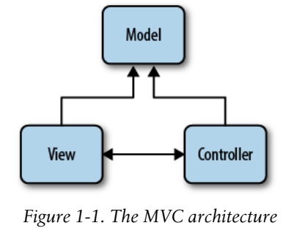
Figure 1-1

Slide 14
The Model
The model represents core business logic and data.
Models encapsulate the properties and behavior of a domain entity and expose properties that describe the entity.
For example, the Auction class represents the concept of an “auction” in the application and may expose properties such as Title and CurrentBid, as well as exposing behavior in the form of methods such as Bid( ).

Slide 15
The View
The view is responsible for transforming a model or models into a visual representation.
In web applications, this most often means generating HTML to be rendered in the user’s browser, although views can manifest in many forms.
For instance, the same model might be visualized in
HTML
PDF
XML
perhaps even in a spreadsheet
Following separation of concerns, views should concentrate only on displaying data and should not contain any business logic themselves—the business logic stays in the model, which should provide the view with everything it needs.

Slide 16
The Controller
The controller, as the name implies, controls the application logic and acts as the coordinator between the view and the model.
Controllers receive input from users via the view, then work with the model to perform specific actions, passing the results back to the view.

Slide 17
What’s New in ASP.NET MVC 4?
This book explores the ASP.NET MVC Framework in depth, showing how to make the most of the features and functionality it offers.
Since we’re now up to the fourth version of the framework, however, much of what the book covers is functionality that existed prior to this latest version.
If you are already familiar with previous versions of the framework, you’re probably eager to skip over what you already know and begin learning all about the new additions.
The list below gives a brief description of each of the features new to version 4 of ASP.NET MVC, along with references pointing you to the sections of the book that show these features in action:
Asynchronous controllers
Display modes
Bundling and minification
Web API

Slide 18
Asynchronous controllers
Internet Information Server (IIS) processes each request it receives on a new thread, so each new request ties up one of the finite number of threads available to IIS, even if that thread is sitting idle (for example, waiting for a response from a database query or web service).
And, while recent updates in .NET Framework 4.0 and IIS 7 have drastically increased the default number of threads available to the IIS thread pool, it’s still a good practice to avoid holding on to system resources for longer than you need to.
Version 4 of the ASP.NET MVC Framework introduces asynchronous controllers to better handle these types of long-running requests in a more asynchronous fashion.
Through the use of asynchronous controllers, you can tell the framework to free up the thread that is processing your request, letting it perform other processing tasks while it waits for the various tasks in the request to finish.
Once they finish, the framework picks up where it left off, and returns the same response as if the request had gone through a normal synchronous controller —except now you can handle many more requests at once!
If you’re interested in learning more about asynchronous controllers, see Chapter 11, which explains them in depth.

Slide 19
Display modes
A growing number of devices are Internet-connected and ready to surf your site, and you need to be ready for them.
Many times, the data displayed on these devices is the same as the data displayed on desktop devices, except the visual elements need to take into consideration the smaller form factor of mobile devices.
ASP.NET MVC display modes provide an easy, convention-based approach for tailoring views and layouts to target different devices.
Chapter 10 shows how to apply display modes to your site as part of a holistic approach to adding mobile device support to your sites.

Slide 20
Bundling and minification
Even though it may seem like the only way to get on the Internet these days is through some sort of high-speed connection, that doesn’t mean you can treat the client-side resources that your site depends on in a haphazard manner.
In fact, when you consider how the overall download times are increasing, wasting even fractions of a second in download times can really add up and begin to have a very negative effect on the perceived performance of your site.
Concepts such as script and stylesheet combining and minification may not be anything new, but with the .NET Framework 4.5 release, they are now a fundamental part of the framework.
What’s more, ASP.NET MVC embraces and extends the core .NET Framework functionality to make this tooling even more usable in your ASP.NET MVC applications.
Chapter 13 helps you tackle all of these concepts and also shows you how to use the new tooling offered in the core ASP.NET and ASP.NET MVC Frameworks.

Slide 21
Web API
Simple HTTP data services are rapidly becoming the primary way to supply data to the ever-increasing variety of applications, devices, and platforms.
ASP.NET MVC has always provided the ability to return data in various formats, including
JSON
XML
however, the ASP.NET Web API takes this interaction a step further, providing a more modern programming model that focuses on providing full-fledged data services rather than controller actions that happen to return data.
In Chapter 6, you’ll see how to really take advantage of AJAX on the client—and you’ll use ASP.NET Web API services to do it!

Slide 22
Did you Know…?
ASP.NET MVC is open source! That’s right—as of March 2012, the entire source code for the ASP.NET MVC, Web API, and Web Pages Frameworks is available to browse and download on CodePlex.
What’s more, developers are free to create their own forks and even submit patches to the core framework source code!

Slide 23
Introduction to EBuy
This book aims to show you not only the ins and outs of the ASP.NET MVC Framework, but also how to leverage the framework in real-world applications.
The problem with such applications is that the very meaning of “real-world” indicates a certain level of complexity and uniqueness that can’t be adequately represented in a single demo application.
Instead of attempting to demonstrate solutions to every problem you may face, we— the authors of this book—have assembled a list of the scenarios and issues that we have most frequently encountered and that we most frequently hear of others encountering.
Though this list of scenarios may not include every scenario you’ll face while developing your application, we believe it represents the majority of the real-world problems that most developers face over the course of creating their ASP.NET MVC applications.
In order to cover the scenarios on this list, we came up with a web application that combines them all into as close to a real-world application as we could get, while still limiting the scope to something everyone understands:
an online auction site

Slide 24
NOTE
We’re not kidding, we actually wrote a list—and it’s in the back of this book! Appendix D has a cross-referenced list of all the features and scenarios we cover and the chapter(s) in which we cover them.
OK, we’ll admit that EBuy is also “just a bunch of code.”
In fact, you can download EBuy in its entirety from the book’s website: http://www.programmingaspnetmvc.com.
Now, let’s stop talking about an application that doesn’t exist yet and start building it!

Slide 25
Ebuy
Introducing EBuy, the online auction site powered by ASP.NET MVC!
From a high level, the goals of the site are pretty straightforward: allow users to list items they wish to sell, and bid on items they wish to buy.
As you take a deeper look, however, you’ll begin to see that the application is a bit more complex than it sounds, requiring not only everything ASP.NET MVC has to offer, but also integration with other technologies.
EBuy is not just a bunch of code that we ship along with the book, though.
Each chapter of the book not only introduces more features and functionality, but uses them to build the EBuy application—from new project to deployed application, preferably while you follow along and write the code, too!

Slide 26
Installing ASP.NET MVC
In order to begin developing ASP.NET MVC applications, you’ll need to download and install the ASP.NET MVC 4 Framework.
This is as easy as visiting the ASP.NET MVC website and clicking the Install button.
This launches the Web Platform Installer, a free tool that simplifies the installation of many web tools and applications.
Follow the Web Platform Installer wizard to download and install ASP.NET MVC 4 and its dependencies to your machine.
Note that in order to install and use ASP.NET MVC 4, you must have
at least PowerShell 2.0 and
Visual Studio 2010 Service Pack 1 or Visual Web Developer Express 2010 Service Pack
Luckily, if you do not already have them installed, the Web Platform Installer should figure it out and proceed to download and install the latest versions of PowerShell and Visual Studio for you!
Once you’ve gotten everything installed, it’s time to proceed to the next step: creating your first ASP.NET MVC 4 application.

Slide 27
NOTE
If you are currently using the previous version of ASP.NET MVC and would like to both create ASP.NET MVC 4 applications and continue working with ASP.NET MVC 3 applications, fear not—ASP.NET MVC can be installed and run side by side with ASP.NET MVC 3 installations.

Slide 28
Creating an ASP.NET MVC Application
The ASP.NET MVC 4 installer adds a new Visual Studio project type named ASP.NET MVC 4 Web Application.
This is your entry point to the world of ASP.NET MVC and is what you’ll use to create the new EBuy web application project that you’ll build on as you progress through this book.
To create a new project, select the Visual C# version of the ASP.NET MVC 4 Web Application template and enter Ebuy.Website into the Name field (see Figure 1-2).
When you click OK to continue, you’ll be presented with another dialog with more options (see Figure 1-3).
This dialog lets you customize the ASP.NET MVC 4 application that Visual Studio is going to generate for you by letting you specify what kind of ASP.NET MVC site you want to create.

Slide 29
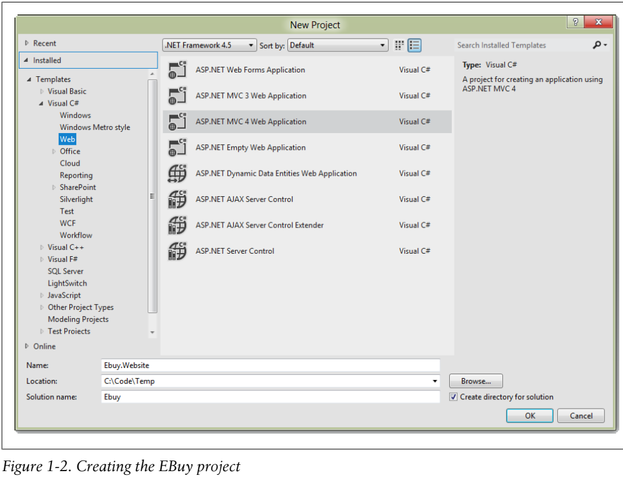
Figure 1-2

Slide 30
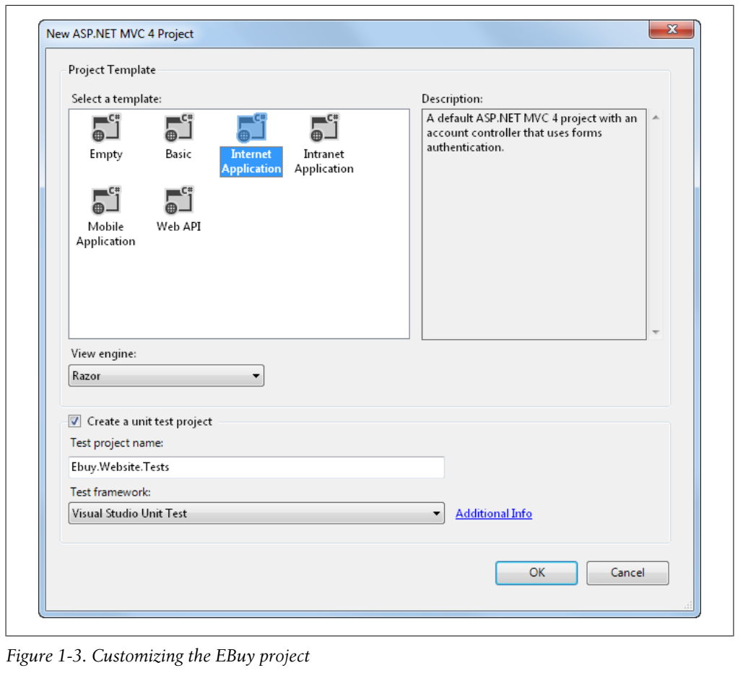
Figure 1-3

Slide 31
Project Templates
To begin, ASP.NET MVC 4 offers several project templates, each of which targets a different scenario:
Empty Basic
Internet Application Intranet Application
Mobile Application Web API
The New ASP.NET MVC Project dialog also lets you select a view engine, or syntax that your views will be written in.
We’ll be using the new Razor syntax to build the EBuy reference application, so you can leave the default value (“Razor”) selected.
Rest assured that you can change the view engine your application uses at any time—this option exists only to inform the wizard of the kind of views it should generate for you, not to lock the application into a specific view engine forever.
Finally, choose whether or not you’d like the wizard to generate a unit test project for this solution.
Once again, you don’t have to worry about this decision too much—as with any other Visual Studio solution, you are able to add a unit test project to an ASP.NET MVC web application anytime you’d like.
When you’re happy with the options you’ve selected, click OK to have the wizard generate your new project!

Slide 32
Templates Explained
The following explains each Template:
Empty: The Empty template creates a bare-bones ASP.NET MVC 4 application with the appropriate folder structure that includes references to the ASP.NET MVC assemblies as well as some JavaScript libraries that you’ll probably use along the way.
The template also includes a default view layout and generates a Global.asax file that includes the standard configuration code that most ASP.NET MVC applications will need.
Basic: The Basic template creates a folder structure that follows ASP.NET MVC 4 conventions and includes references to the ASP.NET MVC assemblies.
This template represents the bare minimum that you’ll need to begin creating an ASP.NET MVC 4 project, but no more—you’ll have to do all the work from here!
Internet Application: The Internet Application template picks up where the Empty template leaves off, extending the Empty template to include a simple default controller (Home Controller), an AccountController with all the logic required for users to register and log in to the website, and default views for both of these controllers.
Intranet Application: The Intranet Application template is much like the Internet Application template, except that it is preconfigured to use Windows-based authentication, which is desirable in intranet scenarios.

Slide 33
Templates Explained |
Mobile Application: The Mobile Application template is another variation of the Internet Application template.
This template, however, is optimized for mobile devices and includes the jQuery Mobile JavaScript framework and views that apply the HTML that works best with jQuery Mobile.
Web API: The Web API template is yet another variation of the Internet Application template that includes a preconfigured Web API controller.
Web API is the new lightweight, RESTful HTTP web services framework that integrates quite nicely with ASP.NET MVC.
Web API is a great choice for quickly and easily creating data services that your AJAX-enabled applications can easily consume.
Chapter 6 covers this new API in great detail.

Slide 34
Convention over Configuration
To make website development easier and help developers be more productive, ASP.NET MVC relies on the concept of convention over configuration whenever possible.
This means that, instead of relying on explicit configuration settings, ASP.NET MVC simply assumes that developers will follow certain conventions as they build their applications.
The ASP.NET MVC project folder structure (Figure 1-4) is a great example of the framework’s use of convention over configuration.
There are three special folders in the project that correspond to the elements of the MVC pattern:
Controllers
Models
Views
It’s pretty clear at a glance what each of these folders contains.
At first glance, the concept of convention over configuration may seem trivial.
However, these seemingly small or meaningless optimizations can really add up to significant time savings, improved code readability, and increased developer productivity.

Slide 35
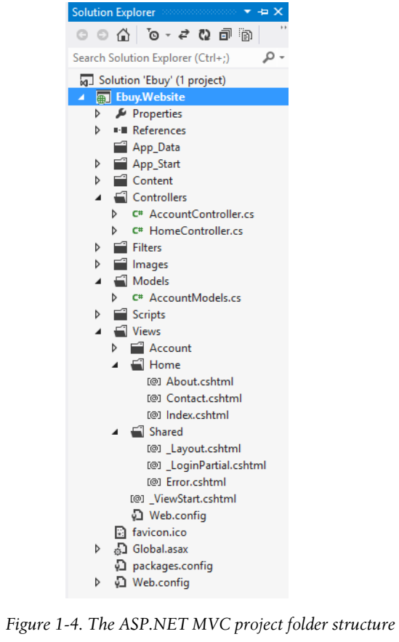
Figure 1-4

Slide 36
Folder Contents
When you look at the contents of these folders, you’ll find even more conventions at work.
For example, not only does the Controllers folder contain all of the application’s controller classes, but the controller classes all follow the convention of ending their names with the Controller suffix.
The framework uses this convention to register the application’s controllers when it starts up and associate controllers with their corresponding routes.
Next, take a look at the Views folder.
Beyond the obvious convention dictating that the application’s views should live under this folder, it is split into subfolders:
a Shared folder
an optional folder to contain the views for each controller
This convention helps save developers from providing explicit locations of the views they’d like to display to users.
Instead, developers can just provide the name of a view—say, “Index”— and the framework will try its best to find the view within the Views folder, first in the controller-specific folder and then, failing that, in the Shared views folder.

Slide 37
Running the Application
Once your project is created, feel free to hit F5 to execute your ASP.NET MVC website and watch it render in your browser.
Congratulations, you’ve just created your first ASP.NET MVC 4 application!
After you’ve calmed down from the immense excitement you experience as a result of making words show up in a web browser, you might be left wondering, “What just happened? How did it do that?”
Figure 1-5 shows, from a high level, how ASP.NET MVC processes a request.
Though we’ll spend the rest of this book diving deeper and deeper into the components of that diagram, the next few sections start out by explaining those fundamental building blocks of ASP.NET MVC.

Slide 38
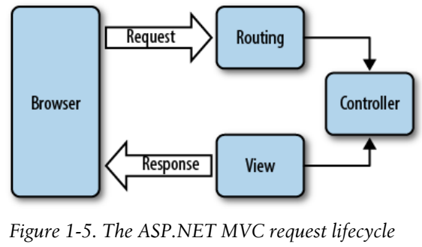
Figure 1-5

Slide 39
Routing
All ASP.NET MVC traffic starts out like any other website traffic:
with a request to a URL
This means that, despite the fact that it is not mentioned anywhere in the name, the ASP.NET Routing framework is at the core of every ASP.NET MVC request.
In simple terms, ASP.NET routing is just a pattern-matching system.
At startup, the application registers one or more patterns with the framework’s route table to tell the routing system what to do with any requests that match those patterns.
When the routing engine receives a request at runtime, it matches that request’s URL against the URL patterns registered with it (Figure 1-6).
When the routing engine finds a matching pattern in its route table, it forwards the request to the appropriate handler for that request.
Otherwise, when the request’s URL does not match any of the registered route patterns, the routing engine indicates that it could not figure out how to handle the request by returning a 404 HTTP status code.

Slide 40
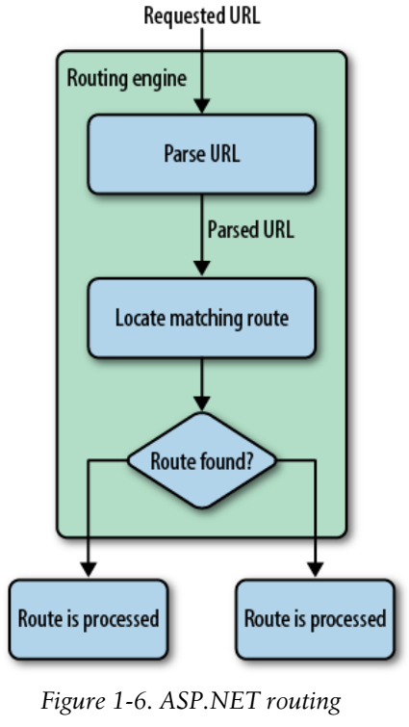
Figure 1-6

Slide 41

Configuring Routes
ASP.NET MVC routes are responsible for determining which controller method (otherwise known as a controller action) to execute for a given URL.
They consist of the following properties:
Unique name: A name may be used as a specific reference to a given route
URL pattern: A simple pattern syntax that parses matching URLs into meaningful segments
Defaults: An optional set of default values for the segments defined in the URL pattern
Constraints: A set of constraints to apply against the URL pattern to more narrowly define the URLs that it matches
The default ASP.NET MVC project templates add a generic route that uses the following URL convention to break the URL for a given request into three named segments, wrapped with brackets ({}): “controller”, “action”, and “id”:
This route pattern is registered via a call to the MapRoute( ) extension method that runs during application startup (located in App_Start/RouteConfig.cs): Code 1-1.

Slide 42
Configuring Routes |
In addition to providing a name and URL pattern, this route also defines a set of default parameters to be used in the event that the URL fits the route pattern, but doesn’t actually provide values for every segment.
For instance, Table 1-1 contains a list of URLs that match this route pattern, along with corresponding values that the routing framework will provide for each of them.
The first URL (/auctions/auction/1234) in the table is a perfect match because it satisfies every segment of the route pattern, but as you continue down the list and remove segments from the end of the URL, you begin to see defaults filling in for values that are not provided by the URL
This is a very important example of how ASP.NET MVC leverages the concept of convention over configuration.
As you may have noticed, URL routes can contain a wealth of information that the routing engine is able to extract.
In order to process an ASP.NET MVC request, however, the routing engine must be able to determine two crucial pieces of information: the controller and the action.
The routing engine can then pass these values to the ASP.NET MVC runtime to create and execute the specified action of the appropriate controller.

Slide 43
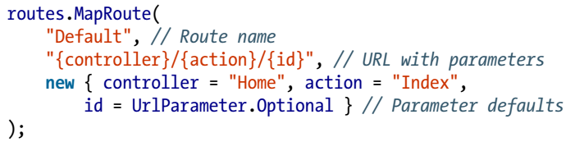
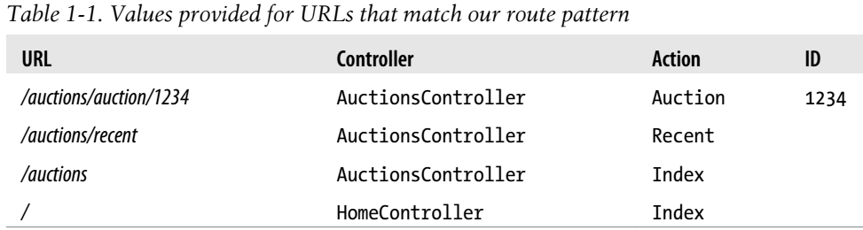
Code 1-1 || Table 1-1

Slide 44
Conventions over Configuration
In the Table 1-1:
When the application starts up, ASP.NET MVC discovers all of the application’s controllers by searching through the available assemblies for classes that implement the System.Web.Mvc.IController interface (or derive from a class that implements this interface, such as System.Web.Mvc.Controller) and whose class names end with the suffix Controller.
When the routing framework uses this list to figure out which controllers it has access to, it chops off the Controller suffix from all of the controller class names.
So, whenever you need to refer to a controller, you do so by its shortened name, e.g., AuctionsController is referred to as Auctions, and Home Controller becomes Home.
What’s more, the controller and action values in a route are not case-sensitive.
This means that each of these requests—/Auctions/Recent, /auctions/Recent, /auctions/ recent, or even /aucTionS/rEceNt—will successfully resolve to the Recent action in the AuctionsController.

Slide 45
NOTE
URL route patterns are relative to the application root, so they do not need to start with a forward slash (/) or a virtual path designator (~/).
Route patterns that include these characters are invalid and will cause the routing system to throw an exception.

Slide 46
Controllers
In the context of the MVC architectural pattern, a controller responds to user input (e.g., a user clicking a Save button) and collaborates between the model, view, and (quite often) data access layers.
In an ASP.NET MVC application, controllers are classes that contain methods that are called by the routing framework to process a request.
To see an example of an ASP.NET MVC controller, take a look at the HomeController class found in Controllers/HomeController.cs: Code 1-2.

Slide 47
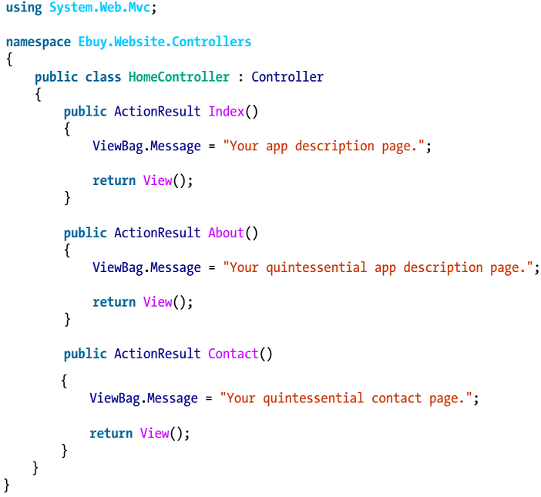
Code 1-2

Slide 48
Controller Actions
As you can see, controller classes themselves aren’t very special; that is, they don’t look much different from any other .NET class.
In fact, it’s the methods in controller classes—referred to as controller actions—that do all the heavy lifting that’s involved in processing requests.
For instance, the HomeController class we just looked at contains three actions:
Index
About
Contact
Thus, given the default route pattern {controller}/{action}/ {id}, when a request is made to the URL /Home/About, the routing framework determines that it is the About( ) method of the HomeController class that should process the request.
The ASP.NET MVC Framework then creates a new instance of the Home Controller class and executes its About( ) method.
In this case, the About( ) method is pretty simple: it passes data to the view via the ViewBag property (more on that later), and then tells the ASP.NET MVC Framework to display the view named “About” by calling the View( ) method, which returns an ActionResult of type ViewResult.

Slide 49
Action Results
It is very important to note that it is the controller’s job to tell the ASP.NET MVC Framework what it should do next, but not how to do it.
This communication occurs through the use of +ActionResult+s, the return values which every controller action is expected to provide.
For example, when a controller decides to show a view, it tells the ASP.NET MVC Framework to show the view by returning a ViewResult.
It does not render the view itself.
This loose coupling is another great example of SoC in action (what to do versus how it should be done).
Despite the fact that every controller action needs to return an ActionResult, you will rarely be creating them manually.
Instead, you’ll usually rely on the helper methods that the System.Web.Mvc.Controller base class provides, such as: List 1-1.
As you can tell from this list, the framework provides an action result for just about any situation you need to support, and, if it doesn’t, you are free to create your own!

Slide 50
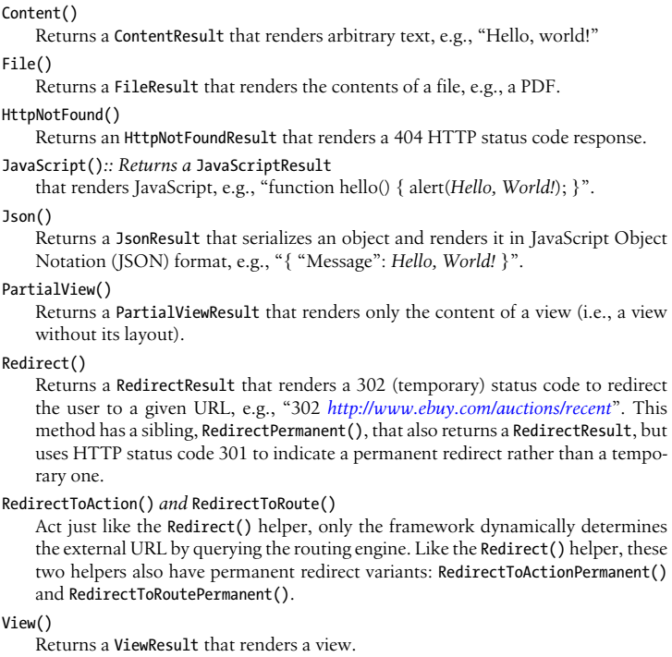
List 1-1

Slide 51
NOTE
Though all controller actions are required to provide an ActionResult that indicates the next steps that should be taken to process the request, not all controller actions need to specify ActionResult as their return type.
Controller actions can specify any return type that derives from ActionResult, or even any other type.
When the ASP.NET MVC Framework comes across a controller action that returns a non-ActionResult type, it automatically wraps the value in a ContentResult and renders the value as raw content.

Slide 52
Action Parameters
Controller actions are—when it comes down to it—just like any other method.
In fact, a controller action can even specify parameters that ASP.NET MVC populates, using information from the request, when it executes.
This functionality is called model binding, and it is one of ASP.NET MVC’s most powerful and useful features.
Before diving into how model binding works, first take a step back and consider an example of the “traditional” way of interacting with request values: List 1-2.
The controller action in this particular example creates and populates the properties of a new Auction object with values taken straight from the request.
Since some of Auction’s properties are defined as various primitive, non-string types, the action also needs to parse each of those corresponding request values into the proper type.
This example may seem simple and straightforward, but it’s actually quite frail: if any of the parsing attempts fails, the entire action will fail.
Switching to the various Try Parse( ) methods may help avoid most exceptions, but applying these methods also means additional code.
The side effect of this approach is that every action is very explicit.

Slide 53
Action Parameters |
The downside to writing such explicit code is that it puts the burden on you, the developer, to perform all the work and to remember to perform this work every time it is required.
A larger amount of code also tends to obscure the real goal: in this example, adding a new Auction to the system.

Slide 54
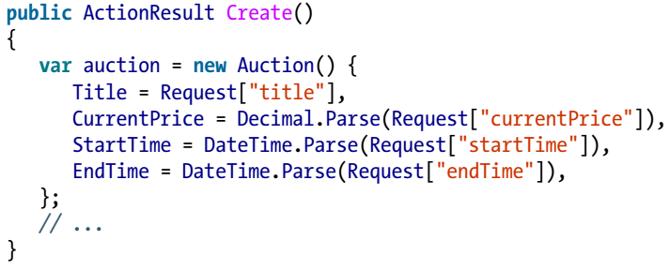
List 1-2

Slide 55
Model binding basics
Not only does model binding avoid all of this explicit code, it is also very easy to apply.
So easy, in fact, that you don’t even need to think about it.
For example, here’s the same controller action as before, this time using model-bound method parameters: List 1-3.
Now, instead of retrieving the values from the Request explicitly, the action declares them as parameters.
When the ASP.NET MVC framework executes this method, it attempts to populate the action’s parameters using the same values from the request that the previous example showed.
Note that—even though we’re not accessing the Request dictionary directly—the parameter names are still very important, because they still correspond to values from in the Request.
The Request object isn’t the only place the ASP.NET MVC model binder gets its values from, however.
Out of the box, the framework looks in several places, such as
route data
query string parameters
form post values
even serialized JSON objects

Slide 56
Model binding basics |
For example, the snippet in Example 1-1 retrieves the id value from the URL simply by declaring a parameter with the same name.
As these examples demonstrate, model binding lets ASP.NET MVC handle much of the mundane, boilerplate code so the logic within the action can concentrate on providing business value.
The code that is left is much more meaningful, not to mention more readable.

Slide 57
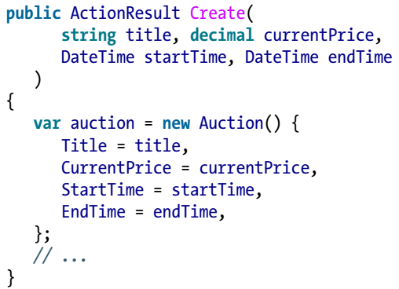
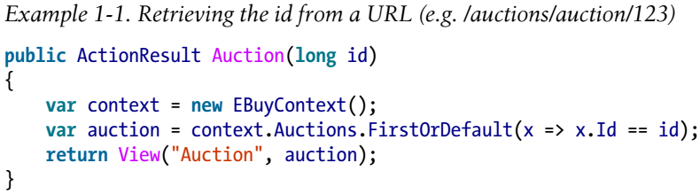
List 1-3 || Example 1-1

Slide 58
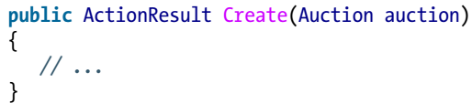
Model binding complex objects
Applying the model binding approach even to simple, primitive types can make a pretty big impact in making your code more expressive.
In the real world, though, things are much more complex—only the most basic scenarios rely on just a couple of parameters.
Luckily, ASP.NET MVC supports binding to complex types as well as to primitive types.
This example takes one more pass at the Create action, this time skipping the middleman primitive types and binding directly to an Auction instance:
The action shown here is equivalent to what you saw in the previous example.
That’s right—ASP.NET MVC’s complex model binding just eliminated all of the boilerplate code required to create and populate a new Auction instance!
This example shows the true power of model binding.

Slide 59
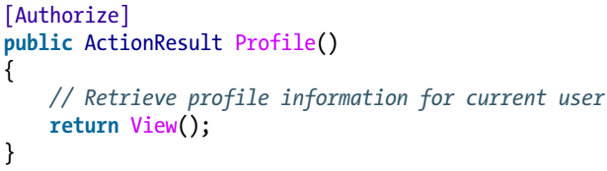
Action Filters
Action filters provide a simple yet powerful technique to modify or enhance the ASP.NET MVC pipeline by “injecting” logic at certain points, helping to address “crosscutting concerns” that apply to many (or all) components of an application.
Application logging is a classic example of a cross-cutting concern in that it is equally applicable to any component in an application, regardless of what that component’s primary responsibility may be.
Action filter logic is primarily introduced by applying an ActionFilterAttribute to a controller action in order to affect how that action executes, as is the case in the following example that protects a controller action from unauthorized access by applying the AuthorizeAttribute:
The ASP.NET MVC Framework includes quite a few action filters that target common scenarios.
You’ll see these action filters in use throughout this book, helping accomplish a variety of tasks in a clean, loosely coupled way.

Slide 60
NOTE
Action filters are a great way to apply custom logic throughout your site.
Keep in mind that you are free to create your own action filters by extending the ActionFilterAttribute base class or any of the ASP.NET MVC action filters.

Slide 61
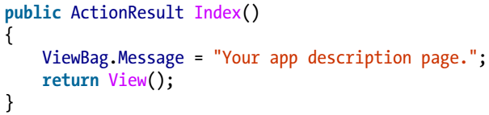
Views
In the ASP.NET MVC Framework, controller actions that wish to display HTML to the user return an instance of ViewResult, a type of ActionResult that knows how to render content to the response.
When it comes time to render the view, the ASP.NET MVC Framework will look for the view using the name provided by the controller.
This action takes advantage of the View( ) helper method to create a ViewResult.
Calling View( ) without any parameters, as in this example, instructs ASP.NET MVC to find a view with the same name as the current controller action.
In this instance, ASP.NET MVC will look for a view named “Index”, but where will it look?

Slide 62
Locating Views
ASP.NET MVC relies on the convention that keeps all the application’s views underneath the Views folder in the root of the website.
More specifically, ASP.NET MVC expects views to live within folders named after the controller to which they relate.
Thus, when the framework wants to show the view for the Index action in the HomeController, it is going to look in the /Views/Home folder for a file named Index.
The project template was nice enough to include an Index.cshtml view for us.
When it does not find a view that matches the name of the view it is looking for in the controller’s Views folder, ASP.NET MVC continues looking in the common /Views/ Shared folder.
The /Views/Shared folder is a great place to keep views that are shared across multiple controllers.
Now that you’ve found the view that the action requested, open it up and take a look at what’s inside:
HTML markup
code
But, it’s not just any HTML markup and code—it’s Razor!

Slide 63
Hello, Razor!
Razor is a syntax that allows you to combine code and content in a fluid and expressive manner.
Though it introduces a few symbols and keywords, Razor is not a new language.
Instead, Razor lets you write code using languages you probably already know, such as C# or Visual Basic .NET.
Razor’s learning curve is very short, because it lets you work with your existing skills rather than requiring you to learn an entirely new language.
Therefore, if you know how to write HTML and .NET code using C# or Visual Basic .NET, you can easily write markup such as the following:
Which produces the following output:
This example begins with a standard HTML tag (the <div> tag), followed by a bit of “hardcoded” text, then a bit of dynamic text rendered as the result of referencing a .NET property (System.DateTime.Now), followed by the closing (</div>) tag.

Slide 64
Razor Parser
Razor’s intelligent parser allows developers to be more expressive with their logic and make easier transitions between code and markup.
Though Razor’s syntax might be different from other markup syntaxes (such as the Web Forms syntax), it’s ultimately working toward the same goal:
rendering HTML
To illustrate this point, take a look at the snippets in Code 1-3 that show examples of common scenarios implemented in both Razor markup and Web Forms markup.
Though they use a different syntax, the two snippets for each of the examples render the same HTML.

Slide 65
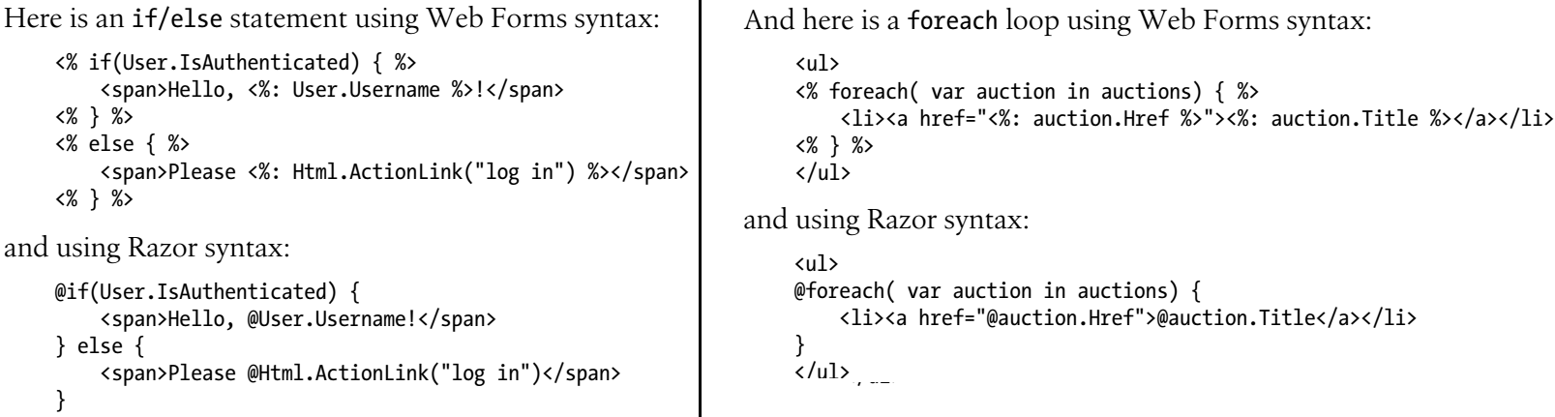
Code 1-3

Slide 66
Differentiating Code and Markup
Razor provides two ways to differentiate code from markup:
code nuggets
code blocks

Slide 67
Code nuggets
Code nuggets are simple expressions that are evaluated and rendered inline.
They can be mixed with text and look like this:
The expression begins immediately after the @ symbol, and Razor is smart enough to know that the closing parenthesis indicates the end of this particular statement.
The previous example will render this output:
Notice that code nuggets must always return markup for the view to render.
If you write a code nugget that evaluates to a void value, you will receive an error when the view executes.

Slide 68
Code blocks

Slide 69
Layouts

Slide 73
Models

Slide 74
Putting It All Together

Slide 75
Authentication

Slide 76
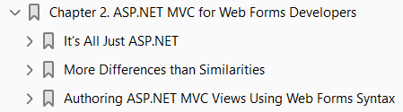
2
ASP.NET MVC for Web Forms Developers

Slide 77
Intro

Slide 78
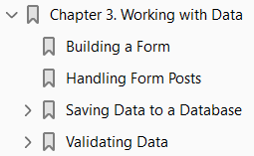
3
Working with Data

Slide 79
Intro
It’s rare to find an application that doesn’t deal with data in some way, so it’s probably no surprise that ASP.NET MVC provides excellent support at all levels of the framework to make working with data much easier.
In this chapter, we’ll take a look at the tools that provide that support and show you how to leverage them in your data-driven scenarios by adding this functionality to the EBuy reference application.
Since EBuy is an auction site, the site’s most important scenario is allowing users to create auction listings that contain the details of the items they would like to sell.
So, let’s take a look at how ASP.NET MVC can help us support this important scenario.

Slide 80
Building a Form
The concept of an HTML form is as old as the Web itself.
Though browsers have gotten more advanced, to the point that you can style an HTML form to look just about any way you like and apply JavaScript to make it behave in ways you wouldn’t have believed possible five years ago, underneath it all is still just a bunch of plain old form fields ready to be populated and posted back to the server.
While ASP.NET MVC encourages you to author much of your HTML markup “by hand,” the framework offers an array of HTML helpers to help generate HTML form markup, such as Html.TextBox, Html.Password, and Html.HiddenField, just to name a few.
ASP.NET MVC also offers a few “smarter” helpers, such as Html.LabelFor and Html.EditorFor, that dynamically determine the appropriate HTML based on the name and type of the model property that is passed in.
It’s these helpers that we’ll leverage in the sample EBuy website to build the HTML form that allows users to post to the AuctionsController.Create action to create new auctions.
To see these helpers in action, add a new view called Create.cshtml and populate it with the markup in Listing 3-1.

Slide 81
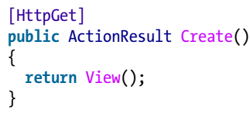
Building a Form |
Then add the following actions to the controller to render this view:
This view renders the following HTML to the browser: Listing 3-2.
The user can then populate the values in this form and submit it to the /auctions/create action.
Though from the browser’s point of view it seems like the form is posting back to itself (the URL to render this form initially is also /auctions/create), this is where the second Create controller action with the HttpPostAttribute comes into play, telling ASP.NET MVC that it is this overload that handles the POST action of a form post.
Once you’ve verified all this, it’s time to actually do something with those submitted form values—but what?

Slide 82
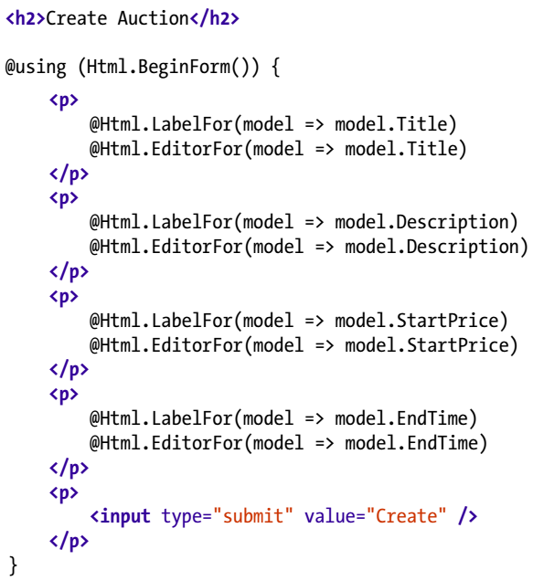
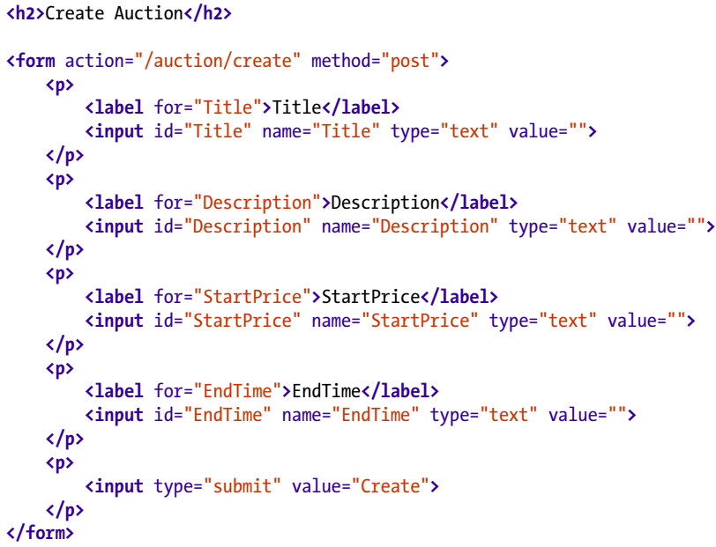
Listing 3-1

Slide 83
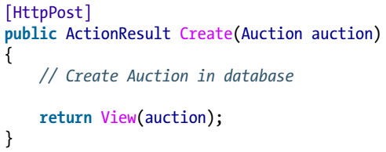
Handling Form Posts
Before you can work with values that are getting posted to a controller, you first need to retrieve them from the request.
As you may remember from “Action Parameters” on page 21, the simplest way is to use a model as an action parameter and, lucky for us, we happen to have created a model already: refer back to the Auction class from “Models” on page 34.
To bind to the Auction class we created earlier, simply specify a parameter of type Auction as one of the Create controller action’s parameters:
The most important aspect of the Auction model at this point is the fact that the property names (Title, Description, etc.) match the form field names that get posted to the Create action.
These property names are crucial, as ASP.NET MVC model binding attempts to populate their values from the form fields with matching names.

Slide 84
Handling Form Posts |
If you run the application, submit your form post, and refresh the page, you’ll see that the Auction model is populated with the values that you entered.
For now, the action just returns the populated auction parameter back to the view, which you might use to display the form values back to the user to confirm his submission.
This is helpful because it gets us one step closer to actually achieving something useful with our application, but there is still more that we need to do, starting with actually saving the data.

Slide 85
Saving Data to a Database
Though the ASP.NET MVC Framework does not have any kind of data access built directly into it, there are many popular .NET data access libraries that can help make working with a database easier.
Microsoft’s Entity Framework—also known as “EF"—is one such library.
Entity Framework is a simple and flexible object relational mapping (ORM) framework that helps developers query and update data stored in a database in an object-oriented way.
What’s more, Entity Framework is actually part of the .NET Framework, with Microsoft’s full support and a wealth of available documentation to back it.
Entity Framework offers a few different approaches to define a data model and use that model to access a database, but perhaps the most intriguing technique is an approach labeled Code First.
Code First development refers to the development mindset wherein your application’s model is the central focus and primary driver behind everything that happens during development.

Slide 86
EF CF: Convention over Configuration

Slide 87
Creating a Data Access Layer with EF CF

Slide 88
Validating Data

Slide 89
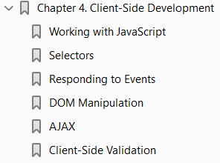
4
Client-Side Development

Slide 90
Intro

Slide 91
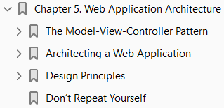
5
Web Application Architecture

Slide 92
Intro

Slide 93
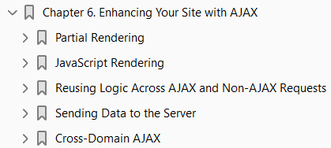
6

Slide 94
Intro

Slide 95
7

Slide 96
Intro

Slide 97
8

Slide 98
Intro

Slide 99
9

Slide 100
Intro

Slide 101
11

Slide 102
Intro

